Slide 1
Vocabulary 6.4
Impressment
Embargo
Unprepared
Capture
Outnumbered
Blockade
Port
Invade
Allies
A refusal to trade with another country
Friends
To take control of
A place where ships stop
Forcing sailors to work on another ship
Not read
To enter with force
Closing off an area with ships
When the other side has more soldiers/people than you do

Slide 2
Chapter 6, Section 4

Slide 3
Causes of the War
Impressment
Britain and France were fighting a war in Europe
Britain began capturing American sailors and “impressing” them, or forcing them to work on British ships
By 1807, Britain had seized more than 1,000 American ships

Slide 4
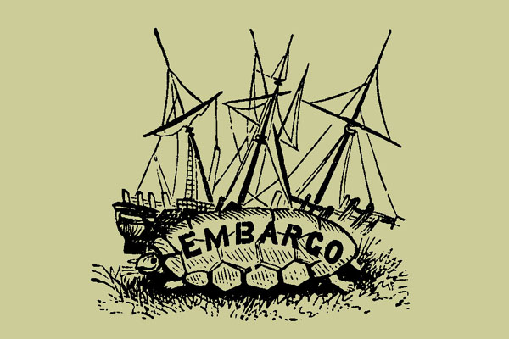
Embargo Act of 1807
President Jefferson convinced Congress to declare an embargo
Jefferson believed the embargo would hurt Britain, but it really hurt America
In 1809, Congress ended the embargo with all countries except Britain and France

Slide 5
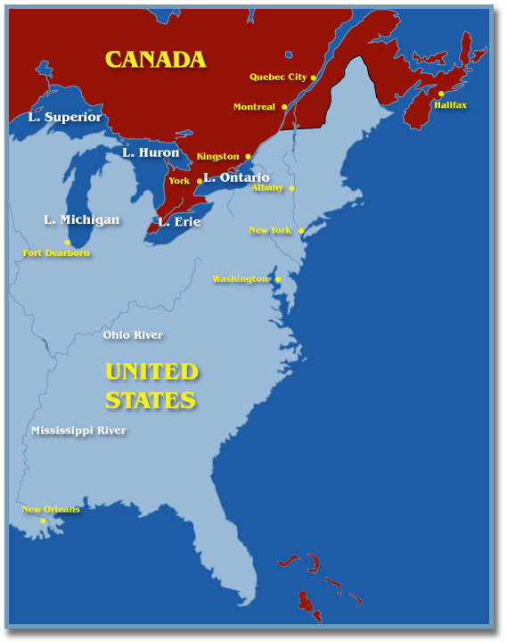
America’s Desire for Canada
Americans saw that Canada was not well-defended by Britain
Americans wanted more land and believed that people in Canada would want to join the United States

Slide 6
The War Hawks
A group of Republican Congressmen from the South and West
Wanted war against Britain
Led by Senator John C. Calhoun of South Carolina and Henry Clary of Kentucky

Slide 7
Election of 1808
James Madison, a Democratic-Republican, won
In the Spring of 1812, Madison decided to go to war against Britain

Slide 8
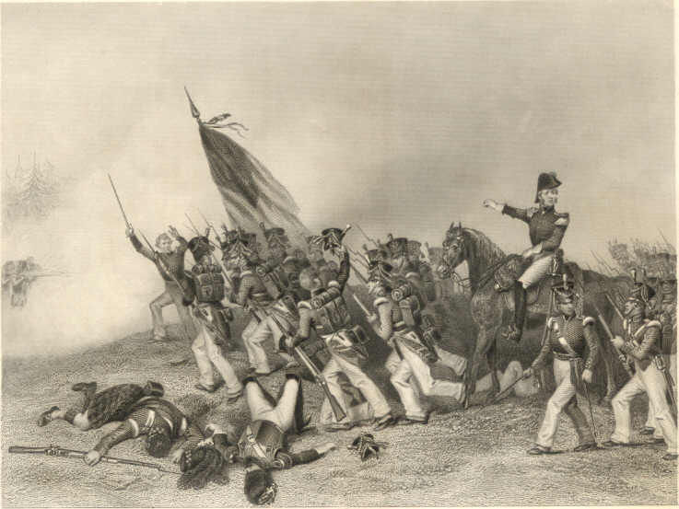
The War in Canada
Americans were unprepared for war
The British captured Detroit and the Americans failed to capture Canada
Many Native Americans helped the British because they wanted to stop Americans from taking more land

Slide 9
The War at Sea
The U.S. Navy was young and outnumbered
In November of 1812, the British blockaded the Chesapeake and Delaware Bays
The blockade grew throughout the war
By 1813, most American ships were unable to leave their ports

Slide 11
The War on Land
Battle for Washington
The British invaded Washington, D.C. in 1814
British soldiers burned the Capitol, the White House, and other public buildings
Before the British burned the White House, Dolley Madison saved a famous painting of George Washington

Slide 12
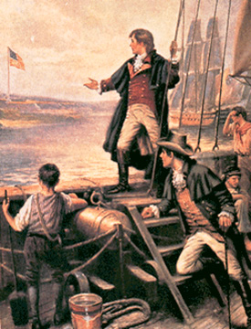
Battle at Fort McHenry
Francis Scott Key: an American lawyer and prisoner of the British
Saw an American flag flying over Ft. McHenry after the battle
The flag inspired Key to write “The Star-Spangled Banner”

Slide 13
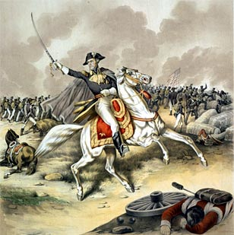
The Battle of New Orleans (1815)
The most famous/important battle of the War
Americans were lead to victory by General Andrew Jackson
The battle continued even after the war ended because word did not reach the Americans for several weeks

Slide 14
The Treaty of Ghent
In December, 1815, British and Americans met in Ghent, Belgium to negotiate a peace treaty
Results of the war:
Britain and American became better allies
America gained respect from other countries

Slide 15
End

Slide 16
This powerpoint was kindly donated to www.worldofteaching.com
http://www.worldofteaching.com is home to over a thousand powerpoints submitted by teachers. This is a completely free site and requires no registration. Please visit and I hope it will help in your teaching.

